Slide 1

INTERNATIONAL FOOTBALL MATCH RESULT FORECASTING WITH MACHINE LEARNING.
2023
2023
2023
BY: TEAM HADOOP
DATE: 24TH JUNE, 2023.
2023

Slide 2
MEET THE TEAM !
01
PROJECT
LEAD
02
ASST. PROJECT LEAD
03
QUERY ANALYST
04
PRESENTERS
MVPs
Adeniyi Olaolu Peter
Getrude Obwoge
Ogunfuyi Taiwo Hassan
Favour Sukat
Lukmon Kazeem
Semiu Biliaminu, Obiageli Jessica Okoli, Emmanuel Mugabo, Chinwendu Nweje, Chidozie Ahamefule, Morka Esther Eberechukwu, Amadi Chimeremma Sandra, Valentine Nthigah, Joseph Nwogwugwu.

Slide 3

Lack of reliable predicting methods.
Inefficient use of available data.
Limited accessibility of predictions.
User demand for reliable insights.
THE PROBLEMS
Notes:
The goal is to develop a prediction algorithm that can leverage historical data and current information to provide reliable insights into the probable outcome of future football matches. Such an algorithm would enable users to make informed decisions, whether for betting purposes, fantasy league competitions, or simply for enhancing their understanding and enjoyment of the sport

Slide 4

—Existing Solutions.
Expert opinions.
Crowd-sourced predictions.
Betting odds.
Online prediction platforms.
Notes:
A mix of either of these have been used too. It is important to note that while existing solutions provide valuable insights and predictions, they may have limitations in terms of accuracy, coverage of factors, or accessibility. The proposed project aims to address these limitations and provide a more accurate and comprehensive prediction algorithm.

Slide 5
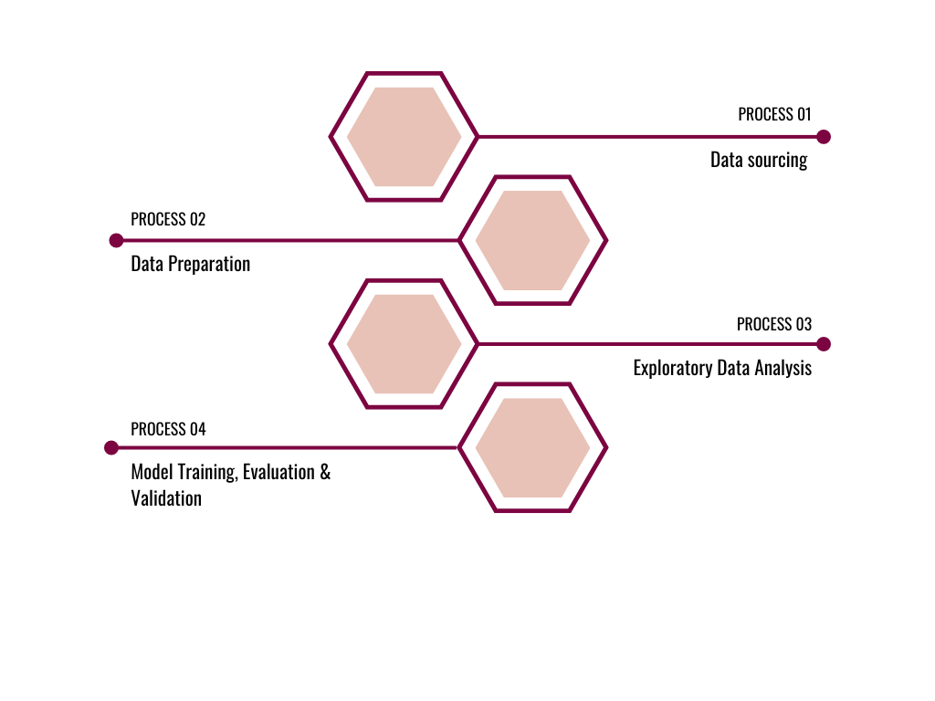
OUR AIM & APPROACH
Aim: To develop a machine learning-based system that accurately predicts football match outcomes, leveraging historical data and advanced analytical techniques.
Fig.1 Flow Process of our project.
SPANISH FEDERATION
Notes:
Data sourcing from Kaggle dataset on international football results.
Data preparation including collection, cleaning, and exploratory data analysis.
Model training and evaluation using a training dataset to construct and validate predictive models.
EDA involves examining and understanding the structure, patterns, and characteristics of the dataset at hand. By exploring the data, we can uncover valuable insights, identify trends, detect anomalies, and gain a deeper understanding of the variables and relationships within the dataset
The dataset was divided into two distinct sets: the training dataset and the testing dataset. The training dataset was employed to construct and validate the models

Slide 6
Dataset Description
Source: https://www.kaggle.com/datasets/martj42/international-football-results-from-1872-to-2017
Features:
Results.csv
44557 rows and 9 columns.
Zero null values
No Duplicates

Slide 7
Data Wrangling, Exploration and Processing
Outliers
Creating target
Drop columns
result: The target contains the result of the football matches
Home_score: 889 outliers
Away_score: 607 outliers
Date column
Encoding
Home team, away team, tournament, city, country

Slide 8
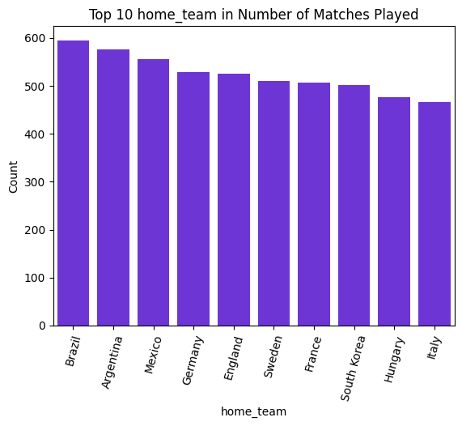
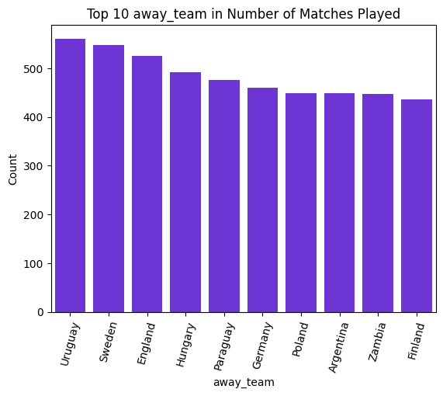
EXPLORATORY DATA ANALYSIS (EDA)
UNIVARIATE ANALYSIS.
The top 3 home teams with the highest number of matches played include Brazil, Argentina & Mexico.
The top 3 away teams with the highest number of matches played are Uruguay, Sweden and England.
Fig. 2
Fig. 3

Slide 9
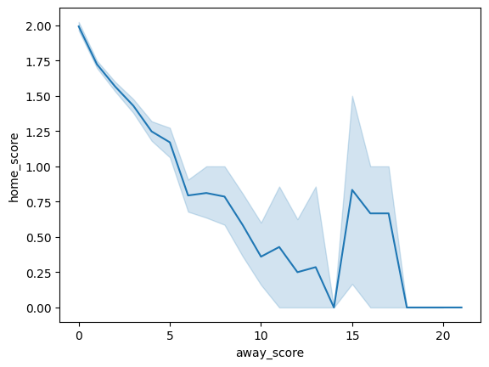
EXPLORATORY DATA ANALYSIS (EDA)
2. BIVARIATE ANALYSIS.
According to the line plot, in cases where the away scores is high, the home score is low.
Fig. 4

Slide 10
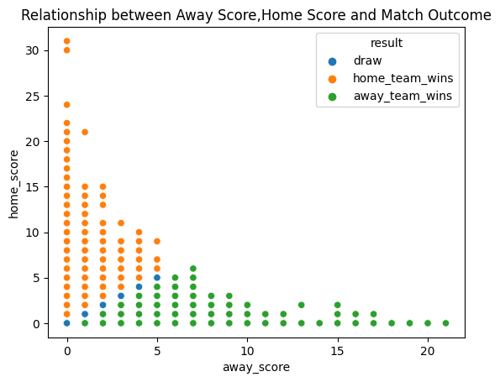
EXPLORATORY DATA ANALYSIS (EDA)
3. MULTIVARIATE ANALYSIS.
The scatter plot demonstrates that higher away scores impact away_team_results and higher home scores influence home_team victories.
Fig. 5

Slide 11
Model
Effectiveness of models on validation data
47%
99%
100%
KNN
Random Forest
XGBoost
Higher accuracy on the training data
Higher accuracy on both the training and validation data
Higher accuracy on both the training and validation data

Slide 12
Accuracy of the chosen model: XGBoost
99%
XGBoost

Slide 13
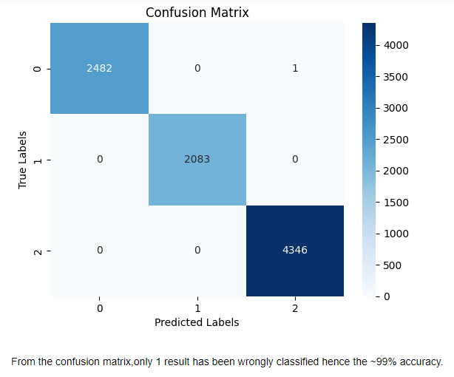
XGBoost: Confusion Matrix

Slide 14
Summary
In summary, in the course of project, dropping or keeping the outlier was a major point of discussion. But the team later reached the a consensus about keeping the outliers, since the outlier are much.
For further and future research, the misclassified class can be explored in order to identify the reason for misclassification, thereby improving the model and thereby getting a better accuracy.

Slide 15
Thank you!

